Slide 1

𝓢𝓾𝓹𝓮𝓻𝓿𝓲𝓼𝓮𝓭 𝓫𝔂 𝓓𝓡.𝓗𝓪𝓶𝓪𝓭𝓪 𝓘𝓫𝓻𝓪𝓱𝓲𝓶 𝓐𝓫𝓭𝓾𝓵𝓦𝓪𝓴𝓮𝓵
𝒮𝒜𝒟𝒜𝒯 𝒜𝒞𝒜𝒟𝐸𝑀𝒴 𝐹𝒪𝑅 𝑀𝒜𝒩𝒜𝒢𝐸𝑀𝐸𝒩𝒯 𝒮𝒞𝐼𝐸𝒩𝒞𝐸𝒮
𝐹𝒶𝒸𝓊𝓁𝓉𝓎 𝑜𝒻 𝑀𝒶𝓃𝒶𝑔𝑒𝓂𝑒𝓃𝓉 𝒮𝒸𝒾𝑒𝓃𝒸𝑒𝓈
𝑀𝒾𝓃𝒾𝒶 𝐵𝓇𝒶𝓃𝒸𝒽, 𝐸𝑔𝓎𝓅𝓉
𝐹𝒾𝓃𝒶𝓁 𝒴𝑒𝒶𝓇 𝒫𝓇𝑜𝒿𝑒𝒸𝓉 𝒯𝒽𝑒𝓈𝒾𝓈
𝐼𝓃 𝓅𝓇𝑒𝓅𝒶𝓇𝒶𝓉𝒾𝑜𝓃 𝒻𝑜𝓇 𝑔𝓇𝒶𝒹𝓊𝒶𝓉𝒾𝑜𝓃
𝒟𝑒𝓅𝒶𝓇𝓉𝓂𝑒𝓃𝓉: 𝑀𝒶𝓃𝒶𝑔𝑒𝓂𝑒𝓃𝓉 𝐼𝓃𝒻𝑜𝓇𝓂𝒶𝓉𝒾𝑜𝓃 𝒮𝓎𝓈𝓉𝑒𝓂
𝒮𝓅𝑜𝓇𝓉𝒾𝓃𝑔 𝑀𝒶𝓃𝒶𝑔𝑒𝓂𝑒𝓃𝓉 𝒲𝑒𝒷𝓈𝒾𝓉𝑒

Slide 2

𝓈𝓅𝑜𝓇𝓉𝒾𝑔 𝒸𝓁𝓊𝒷𝓈
𝒯𝑒𝒶𝓂 𝑀𝑒𝓂𝒷𝑒𝓇𝓈
Maged mamdouh Shehata medomamdouh622003@gmail.com
Ziad Magdy Abdelnaeem ziadfax32@gmail.com
Keroles rafik azmy kerolosrafik347@gmail.com
Mohamed Wageh Kamel mmdwageh0@gmail.com

Slide 3
𝓐𝓰𝓮𝓷𝓭𝓪
1-𝓹𝓻𝓸b𝓵𝓮𝓶
2-𝓼𝓸𝓵𝓾𝓪𝓽𝓲𝓸𝓷
3-𝓢𝓦 𝓭𝓲𝓪𝓰𝓻𝓪𝓶𝓼
4𝓫𝓾𝓼𝓲𝓷𝓮𝓼𝓼𝓪𝓷𝓭𝓶𝓪𝓷𝓰𝓶𝓮𝓷𝓽

Slide 4

𝓹𝓻𝓸b𝓵𝓮𝓶
1. Reservations had to be made by phone or in person
2. Difficulty in confirming the reservation or knowing its status
3. Lack of sufficient information about the stadiums (location, price, type of flooring...)
4. The stadiums were receiving random or overlapping reservations
5. Difficulty communicating with the stadium management
6. Congestion of calls to the reservation management
7. Lack of reports or statistics on stadium usage (for the management)

Slide 5

𝓼𝓸𝓵𝓾𝓪𝓽𝓲𝓸𝓷
We were able to provide an easy-to-use interface for the customer
2. We were able to collect all playgrounds, sizes, prices and excellent locations
3. Our playgrounds are working 24 hours
4. Our playgrounds have a system manager and a database on their system 24 hours a day to follow up on reservations and dates for the playgrounds
5. There are no conflicts in dates and reservations are delayed because the system manager is available 24 hours a day to follow up with customers.

Slide 6

𝒮𝑜𝒻𝓉𝒲𝑒𝒶𝓇 𝓭𝓲𝓪𝓰𝓻𝓪𝓶𝓼
Phone
View Servies
Contact us
Email
Register
Name
Email
Login
Passwerd
Email
Social media
Pass
𝒰𝓈𝑒𝓇
Feedback
View Feedback

Slide 7
Servies
Have 9 Pitches
Arena of Champions
Star ball
Five stars
Skills field
Champions Field
Koura View
Royal Stadium
Victoria Sport
Victoria Sport
five-a-side pitches
five-a-eleven pitches
Have 5 Pitches
1. Minya Sports Club Stadium
2. Minya University Stadium
3. Minya Sports Club Stadium in New Minya
4. Judges Club Stadium
5. Police Officers Club Stadium
Customize pitches
Have 2 pitches
1.The covered hall
2. Aviation Club Stadium

Slide 8
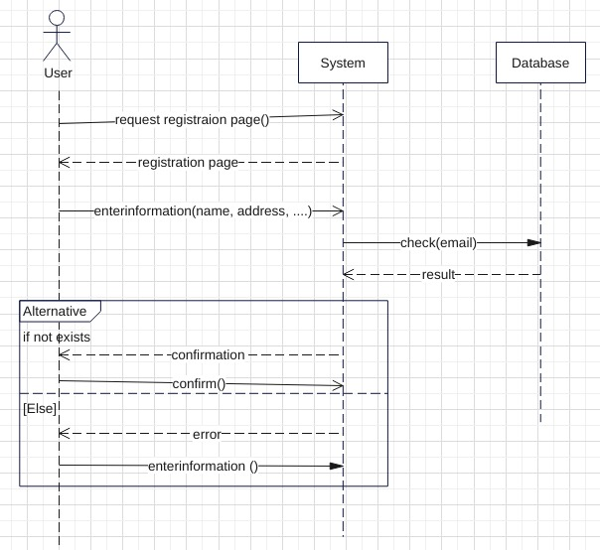
2. 𝓈𝑒𝓆𝓊𝑒𝓃𝒸𝑒 𝒹𝒾𝒶𝑔𝓇𝒶𝓂

Slide 9
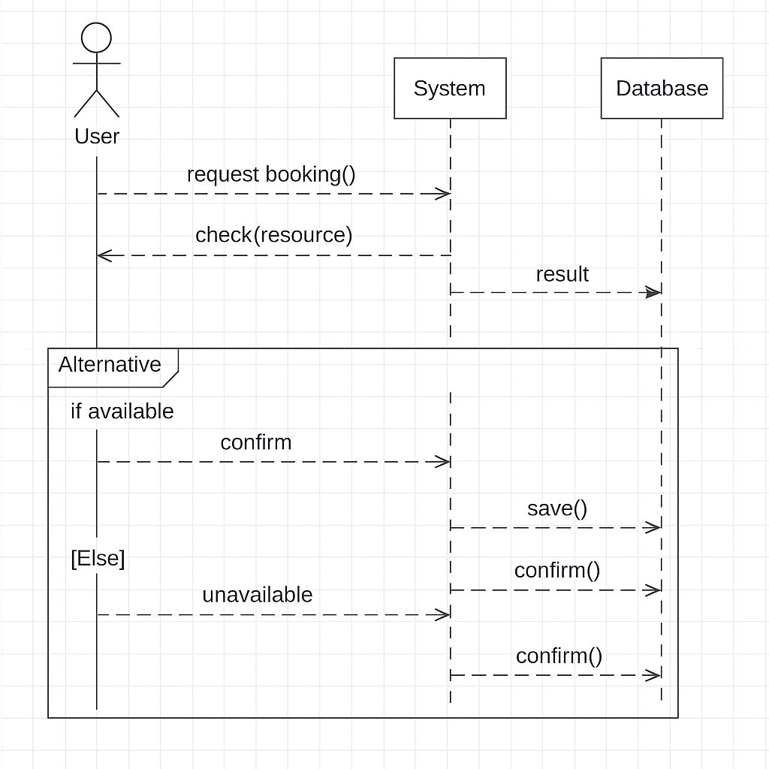

Slide 10
Class diagram
Types
ID : type = int
Name : type = string
Pitches : type : string
Feedback
Comment : type : string
User
Name : type = string
Email : type = string
Password : type = string
write
Make
has
Pitches
Pitches name :type = string
Date : type = integer
Time : type = float
ID : type = int
Phone : type = int
Service
Email : type = string
Address :type = string
Phone :type = int
Pitches : type = string

Slide 11
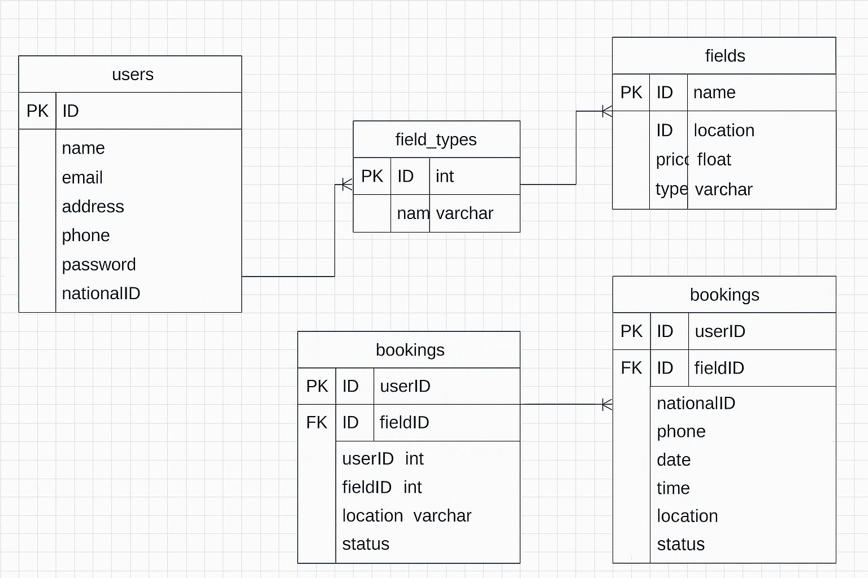
𝒟𝒶𝓉𝒶 𝒷𝒶𝓈𝑒 𝓈𝒸𝒽𝑒𝓂𝒶

Slide 12
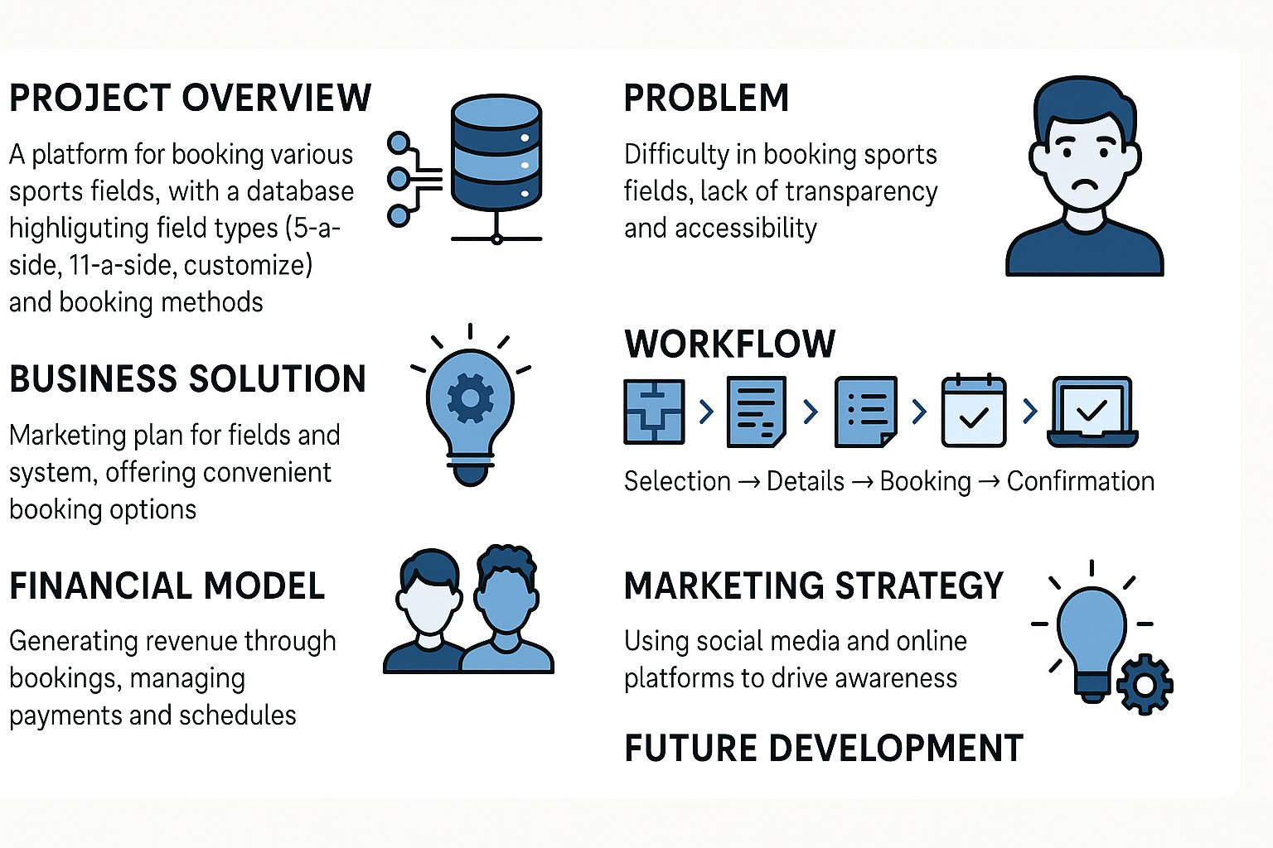
𝓫𝓾𝓼𝓲𝓷𝓮𝓼𝓼𝓪𝓷𝓭𝓶𝓪𝓷𝓰𝓶𝓮𝓷𝓽

Slide 13

The conclusion
Thus, we were able to solve a major problem facing all young people and most ages. Thank you for listening.

